Slide 1
Used Car Price Prediction
By-Unmit Patel

Slide 2
The Problem Definition
Purpose
Appropriately pricing the used cars for business to have maximum returns and buyers or customers do not have to overpay for a vehicle.
Gives businesses a better insights to fluctuate the prices based on market conditions, car characteristics and competitors pricing model.
Objective
The goal is to build a predictive model for used car prices based on their characteristics.
Questions to be answered
How accurately can we predict the price of a used car using the available data?
What is the model's performance on different subsets of the data?
How does missing data affect the accuracy of price predictions?
What methods can we use to handle missing data without significantly compromising model accuracy?

Slide 3
Approach towards solution
EDA
EDA helped in understanding the dataset.
The statistical summary explains the properties of each column or feature.
It helped in identifying the total number of rows in dataset, total number of unique cars, various locations, variety of used car models based on year of manufacture, etc.
Univariate Analysis
Univariate analysis helped in identifying skewed features that needed to be transformed.
‘Kilometers_Driven’, ‘Engine’, ‘Power’, ‘New_price’, and ‘Price’ were the skewed features which were transformed using log-transformation.
Even after performing log-transformation, ‘log_Engine’, ‘log_New_price’, and ‘log_Power’ remains skewed.
Plot bar graphs on categorical features in this dataset which are, ‘Location’, ‘Fuel_type’, ‘Transmission’, and ‘Owner_type’.

Slide 4
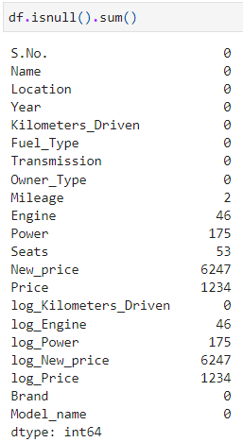
Approach towards solution
Bivariate Analysis
After log-transformation, scatter plot is built between transformed features to check the correlation between them and cluster of data points and their relevance.
The heatmap is created to check if a feature is positively or negatively correlated to other features.
A boxplot is created to check the price range of used cars in each city.
Feature Engineering
The ‘Name’ column is divided into two columns, ‘Brand’ and ‘Model_name’. As the Name column had 2041 unique names, it would be of no use for analysis purposes, hence it separated.
Missing value treatment
There are many features that has several null values. We can overcome this issue by using imputation.

Slide 5
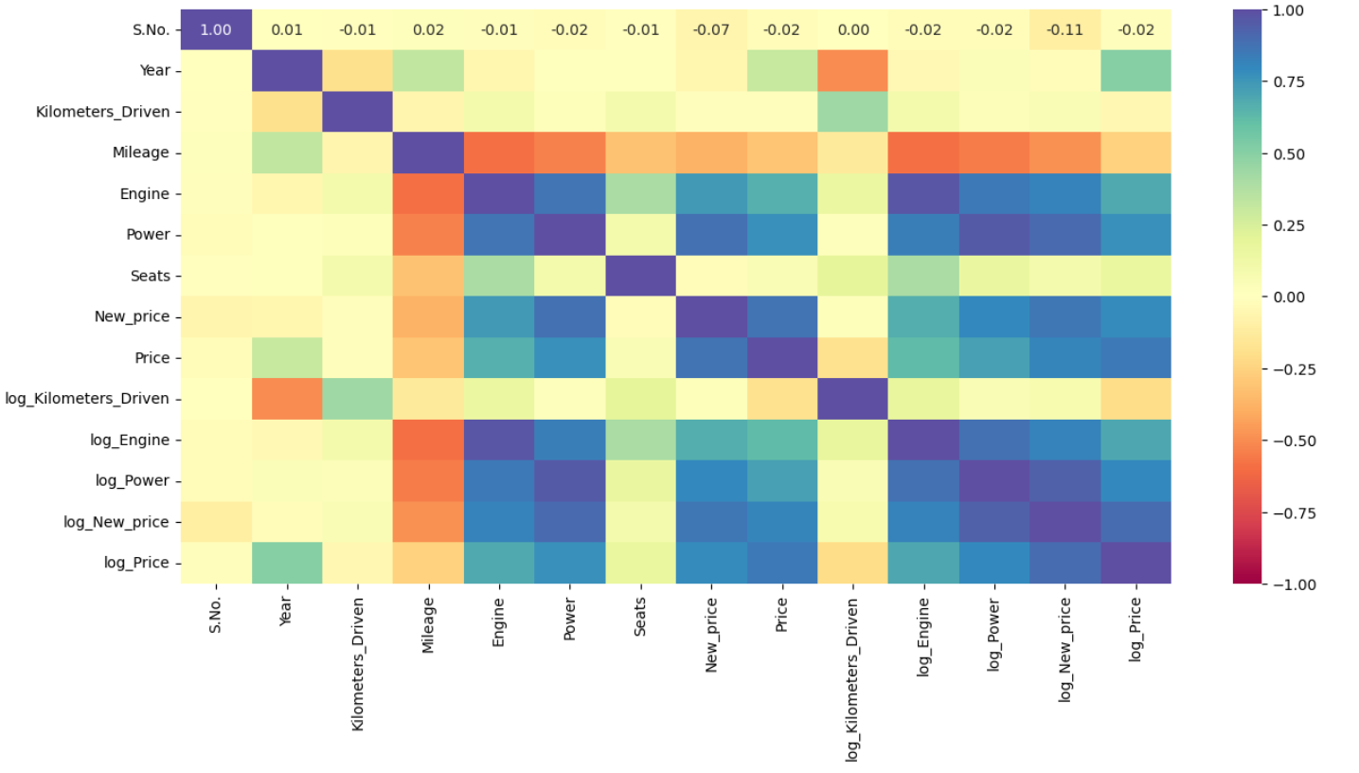

Slide 6
Building Models
Before building any model, the data is split into train and test sections.
‘log_Price’ is the target variable. 'Name’, 'Price’, 'log_Price’, 'Kilometers_Driven', 'Engine', 'Power’, and 'New_price’ independent variables has been removed as there are transformed versions of these independent variables available in dataset.
There is 70:30 ratio split between training and testing data.
A function is created to check the performance of models by calculating RMSE, MAE, and R².

Slide 7


Model performance
Linear Regression
Excellent performance on the training set (high r2 of 0.983894 and low RMSE of 0.109818).
Good performance on the test set, but slightly higher RMSE (0.255109) and lower r2 (0.908895).
This indicates a bit of overfitting, but the model generalizes reasonably well.
Ridge Regression optimized alpha
Good balance between train and test performance.
Lower test RMSE (0.188162) and higher test r2 (0.951492) compared to Linear Regression, indicating better generalization.
Ridge regression has regularization that helps control overfitting, which is evident here.

Slide 8



Model performance
Lasso Regression optimized alpha
Higher RMSE and lower r2 compared to both Linear and Ridge on the training set.
Test performance is better than Linear but worse than Ridge.
Lasso's higher regularization may be causing some underfitting.
Hyper Tuning: Decision Tree
Very low RMSE and high r2 on the training set, indicating significant overfitting.
Test RMSE is higher (0.265036), and r2 is lower (0.906114) compared to Ridge and Lasso, showing poor generalization.
Random Forest
Almost perfect fit on the training set (RMSE nearly zero and r2 of 1), indicating severe overfitting.
Test performance (RMSE of 0.280317, r2 of 0.897866) is worse than all other models, especially Ridge.

Slide 9
Why Ridge Regression?
Generalization: Ridge regression offers the best balance between training and test performance, with a low RMSE and high r2 on the test set. It avoids the overfitting seen in Random Forest and Decision Tree models, while also outperforming Linear and Lasso regression.
Regularization: The regularization in Ridge helps prevent the model from fitting the noise in the data, which is why it generalizes better to unseen data.
Comparison to other models:
Compared to Linear Regression: Ridge regression reduces overfitting, leading to better test performance.
Compared to Lasso Regression: Ridge provides a better fit by not shrinking coefficients as aggressively as Lasso, which avoids underfitting.
Compared to Decision Tree: Ridge regression is less prone to overfitting, leading to better generalization.
Compared to Random Forest: Despite Random Forest's strong training performance, its severe overfitting leads to poor test performance, making Ridge the superior choice for generalization.

Slide 10
Key Recommendations
Further investigation into feature importance might reveal that some features are more influential than others, suggesting the removal or transformation of less important features.
Enrich the dataset with external data (e.g., market trends, economic indicators) that might influence car prices.
Provide stakeholders with an interpretability report (e.g., SHAP values, feature importance) to ensure they understand how the model arrives at its predictions.
Implement a monitoring system to track model performance over time, ensuring it continues to perform well as market conditions change.
Key Actionable for stakeholders
Integrate the Ridge Regression model into the pricing system to assist with setting competitive prices for used cars.
Provide training to sales teams on how the model works and how to use it in decision-making.
Use the model to develop dynamic pricing strategies, adjusting prices based on real-time data and trends.
Streamline data collection processes to ensure that critical car features are accurately recorded at the time of acquisition.
Regularly update the model with new data to keep it relevant and accurate.

Slide 11
Thank you

